Slide 1
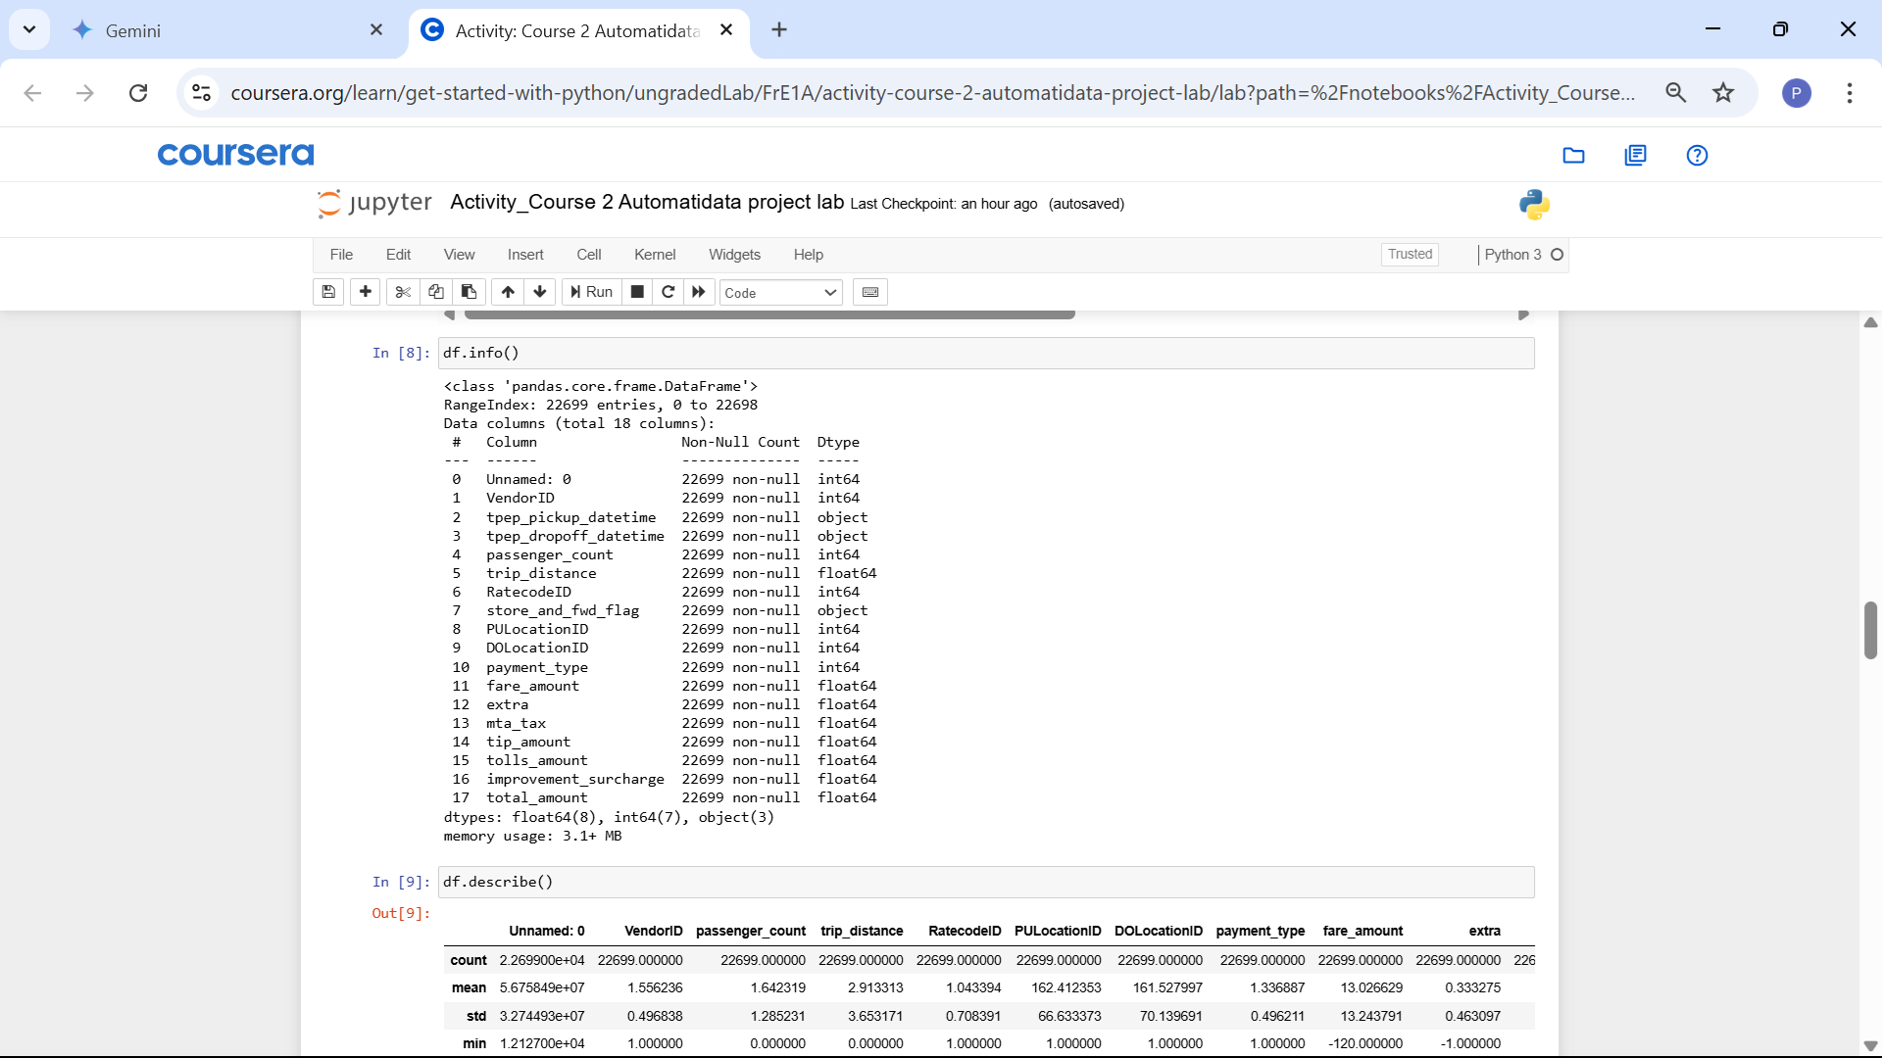
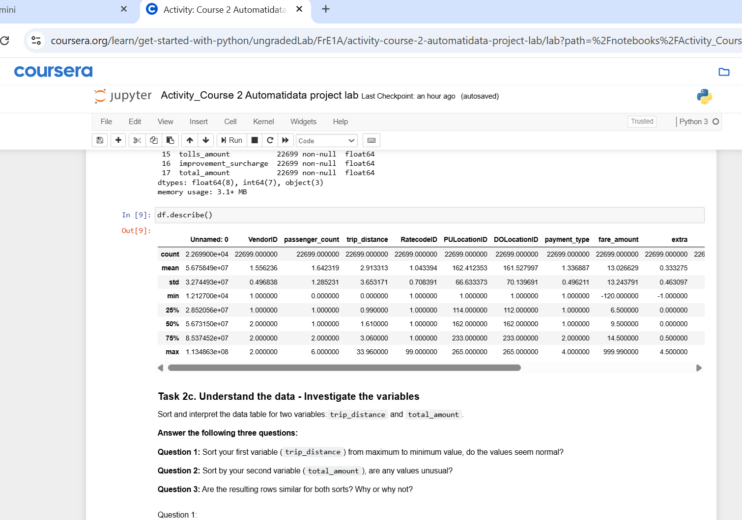
Title: Addressing Data Integrity: Negative Fare Amounts
Subtitle: Finding from Initial 2017 NYC Taxi Data Assessment
Initial analysis using .describe() revealed that fare_amount and total_amount columns contain negative values (e.g., minimum of -120).These negative values are logically impossible for taxi trip costs and indicate significant data errors.
Recommended Action: Investigate these records further and implement a clear rule for handling them before analysis or modeling.Options: This likely involves removing the affected rows or potentially correcting them if a clear reason/pattern for the error can be identified (though removal is often safest for such illogical values).
Image Alt-Text Here
Current: These erroneous values heavily skew summary statistics (especially the mean) and distort understanding of typical fare ranges.
Future: If left unaddressed, they will negatively impact data visualizations, potentially bias model training, and reduce the reliability and accuracy of fare predictions. Cleaning improves data trustworthiness.
Image Alt-Text Here
Highlights the necessity of looking beyond basic completeness checks (like non-null counts) to validate data logic using descriptive statistics (min/max values).Reinforces that data cleaning is a critical prerequisite step before meaningful analysis or modeling can occur.

